Slide 1

IRC Sail Measurement
International Rating Certificate

Slide 2
Who Can Measure Sails for IRC (Endorsed) in the Rule Authority
Rule Authority Appointed Sail Measurers
National Authority Appointed Sail Measurers
IHC Licensed Sail Lofts
(Manufacturers licensed by World Sailing/Rule Authority to certify sails under the IHC scheme)

Slide 3
General Principles
IRC Rule 7.3 invokes the ISAF Equipment Rules of Sailing (ERS).
Section G addresses sails.
Sails are measured in accordance with ERS Part III, Measurement
Rules, Section H5, Sail Measurement.
There are no IRC Rules on sail reinforcement.
There are no current IRC restrictions on type of sailcloth or construction of sails.
The key to successful sail measurement is to establish the corner points (clew, head and tack) correctly.
See ERS G.4.1, 2 and 3.

Slide 4
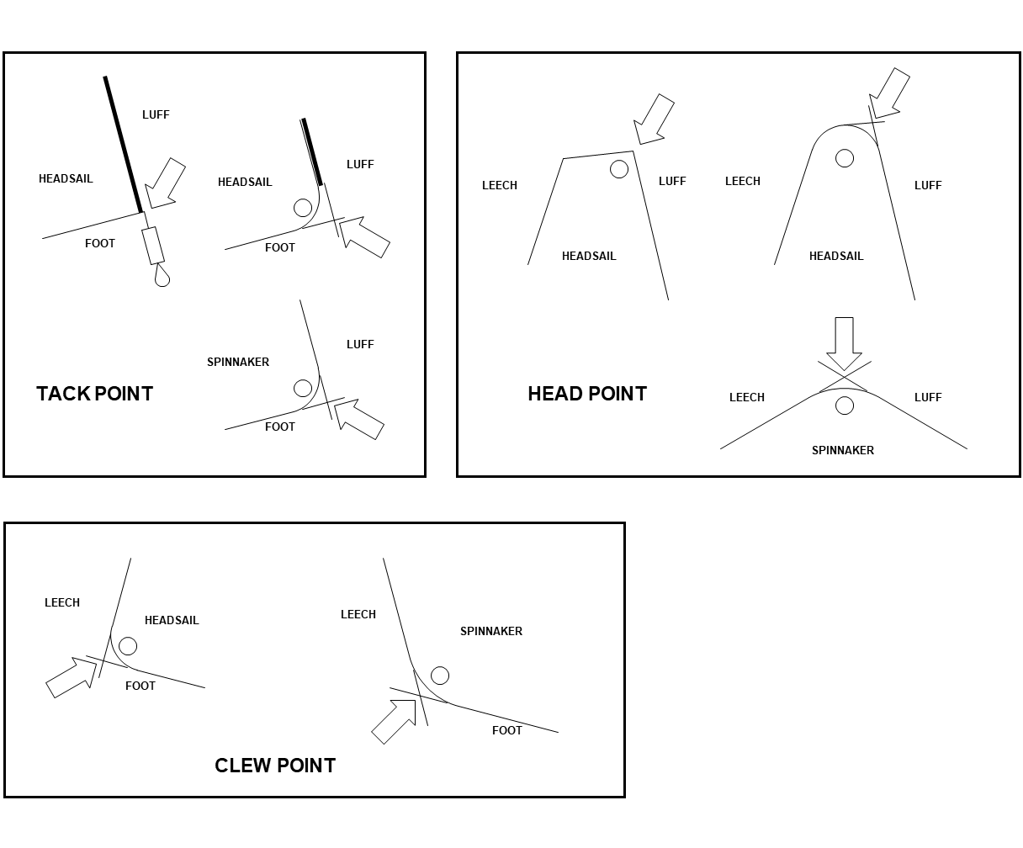
Sail Corner Points
Unfortunately sailmakers don’t make sail corners that match these drawings!

Slide 5
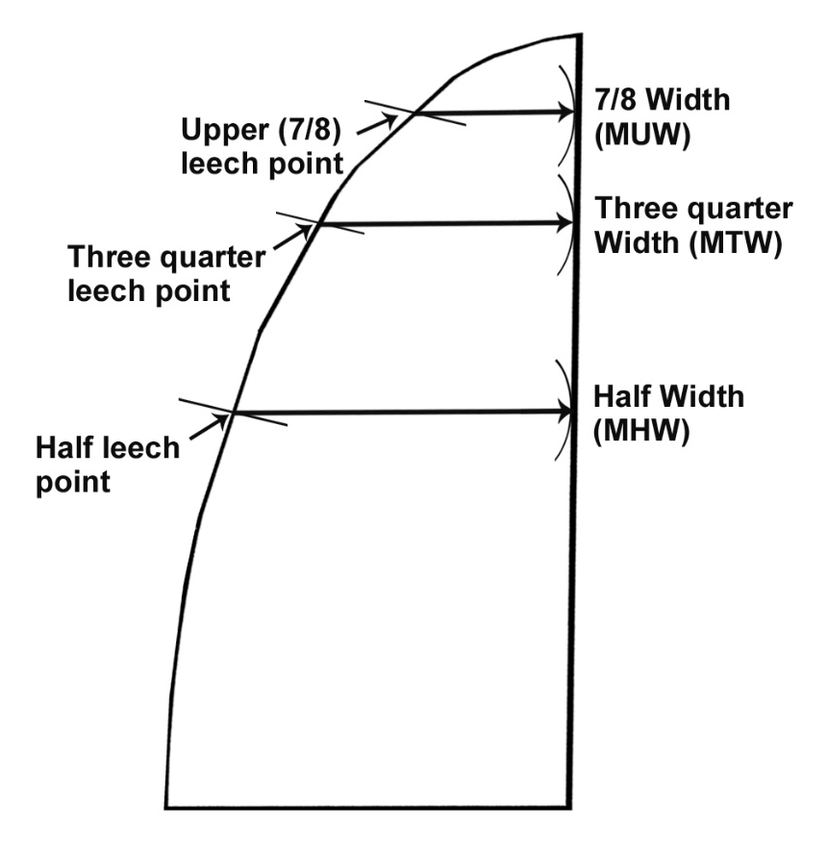
Mainsail
Required Dimensions
For UMS / ORC Measurement you will also need to provide ¼ Width (MQW) & Head Width (MHB)

Slide 6
Mainsail Dimensions
Only dimensions are MHW, MTW, and MUW.
Fold the Head Point to the Clew Point to find Half Leech Point. Then measuring from the leech, find the shortest distance to the luff. Add any leech hollow to get MHW.
Fold the Head Point to the Half Leech Point to find Three Quarter Leech Point. Then measuring from the leech, find the shortest distance to the luff. Add any leech hollow to get MTW.
Fold the Head Point to the Three Quarter Leech Point to find Seven Eighth Leech Point. Then measuring from the leech, find the shortest distance to the luff. Add any leech hollow to get MUW.
Mainsail luff and foot are measured as P & E on the spars, NOT on the sail.

Slide 7
Mainsail Head & Clew Points – ERS Definitions
Clew Point – The intersection of the foot and the leech, each extended as necessary.
Head Point – The intersection of the luff, extended as necessary, and the line through the highest point of the sail at 90° to the luff.

Slide 8
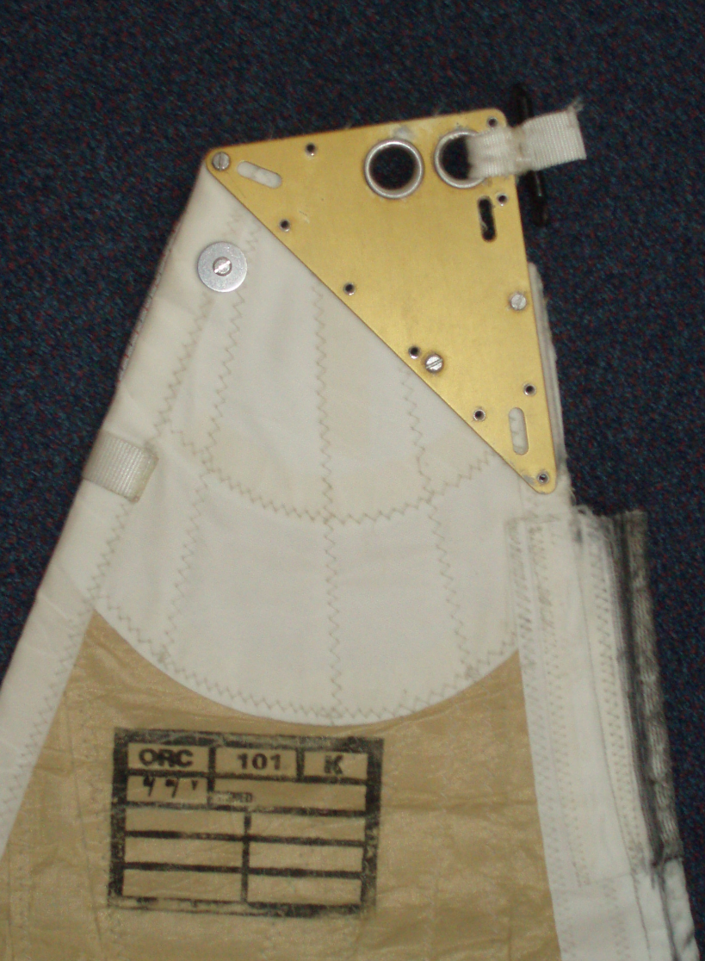
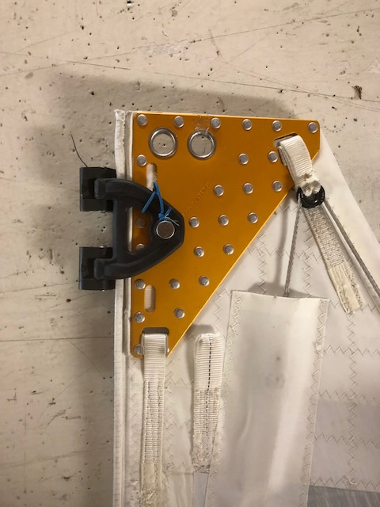
Mainsail Head Point

Slide 9
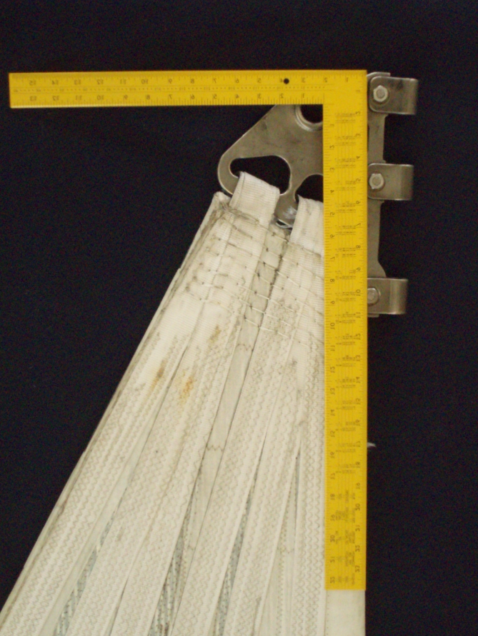
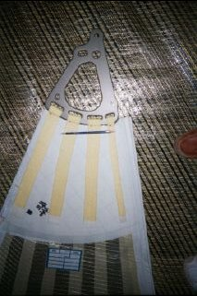
Mainsail

Slide 10
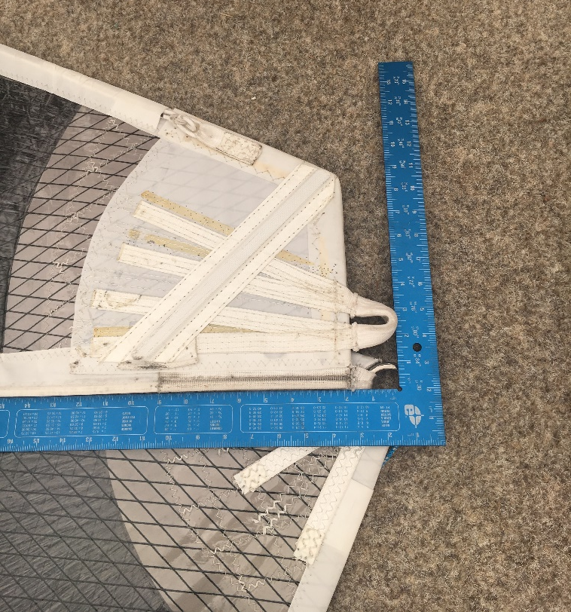
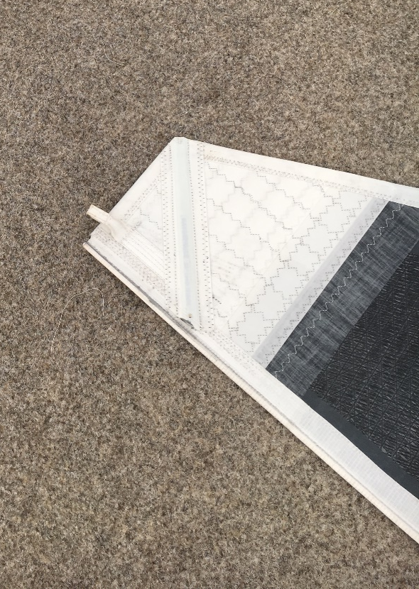
Mainsail Head Points

Slide 11
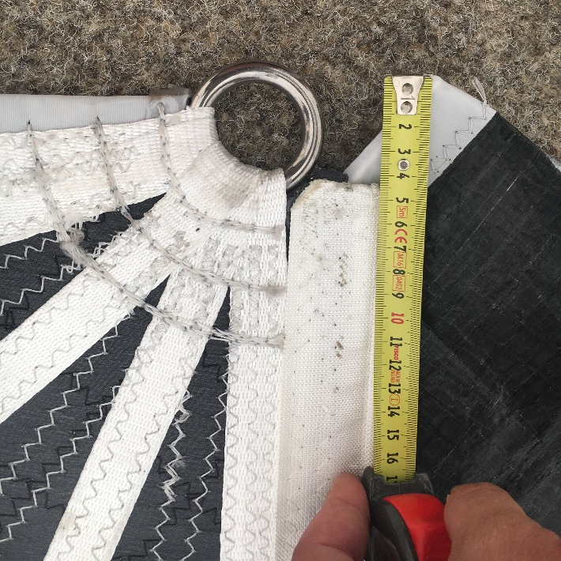
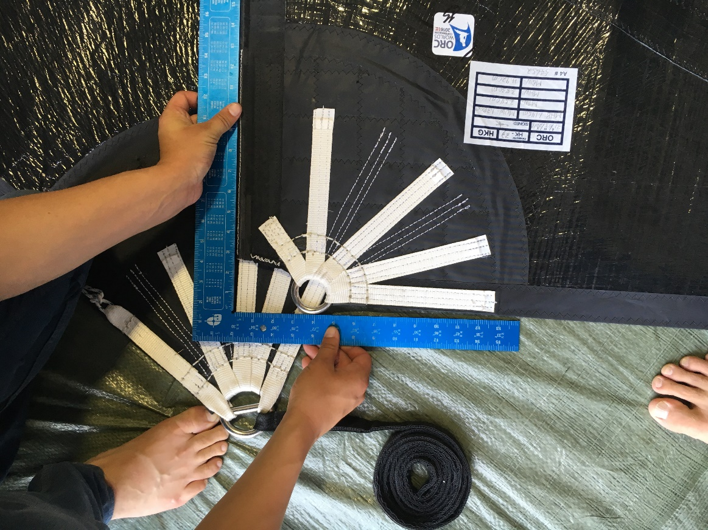
Mainsail Head Points

Slide 12
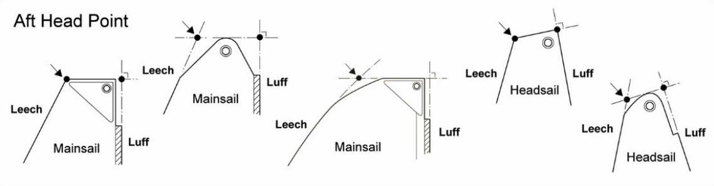
Aft Head Point
G.5.6 Aft Head Point
MAINSAIL and HEADSAIL: The intersection of the leech extended as necessary and the line through the head point at 90° to the luff.

Slide 13
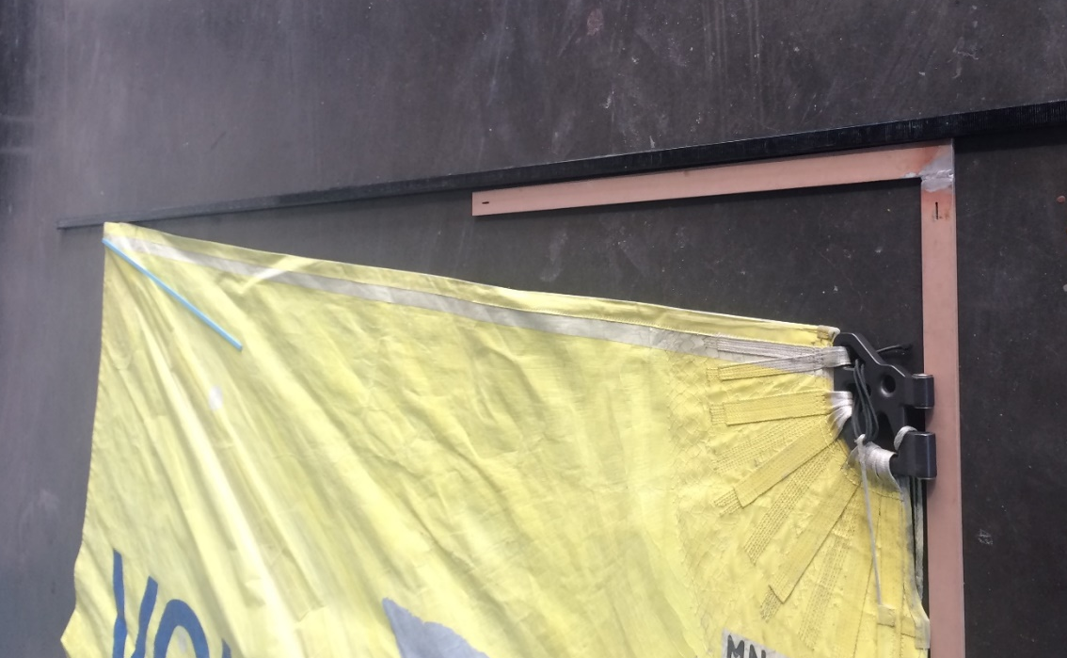
Square Top Main
Check if Aft Head Point is Higher than Head Point
Also remind the Owner that the Upper Limit Mark (Black Band on Rig) is the limit for the highest point on the sail – Which may not be on the luff!

Slide 14
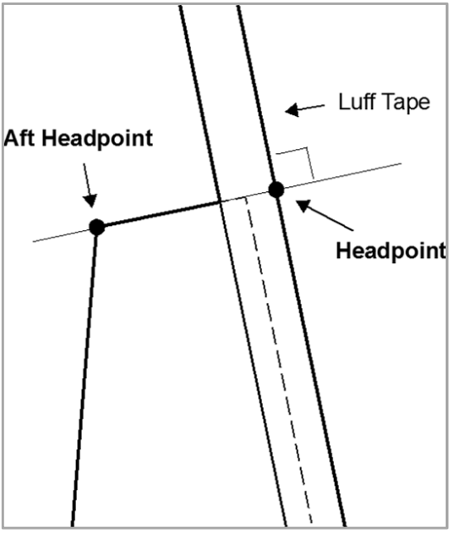
Top Width
G.7.9 Top Width (a) MAINSAIL
and HEADSAIL: the distance between the head point and the aft head point.

Slide 15
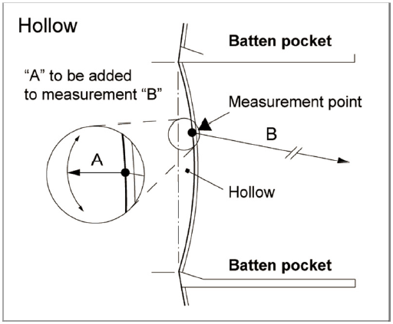
Hollows
Don’t Forget Them – One of the most common discrepancies found during equipment inspection.

Slide 16
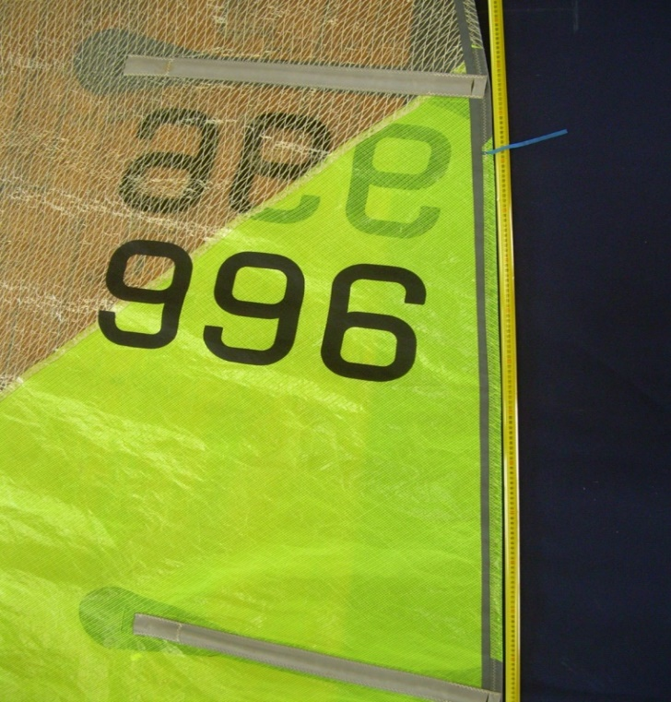
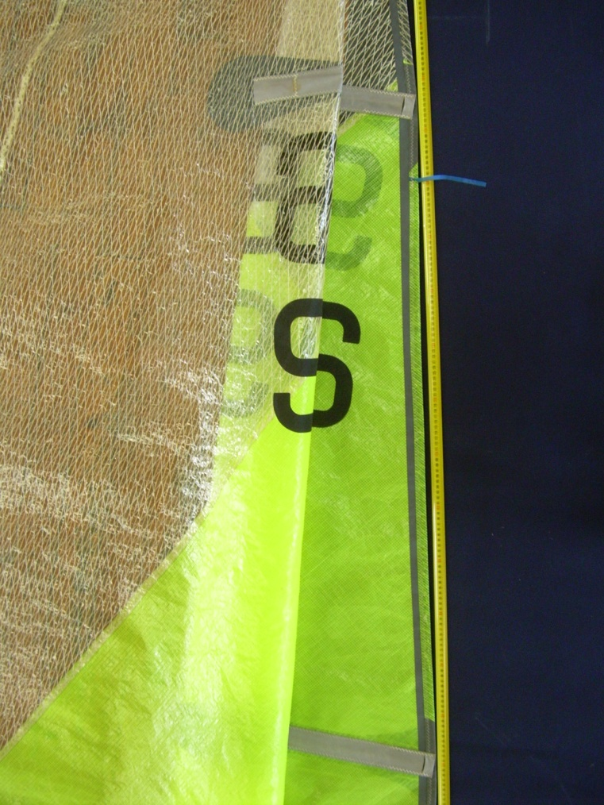
Hollows
Also Don’t Forget To Flake The Sail

Slide 17

Headsail
Required Dimensions
For UMS / ORC Measurement you will also need to provide ¼ Width (MQW) & Head Width (MHB)

Slide 18
Headsail Dimensions
On largest area headsail, measure luff, luff perpendicular, half, three quarter and seven eighth widths (LL, LP, HHW, HTW, HUW).
Fold the Head Point to the Clew Point to find Half Leech Point. Then measuring from the leech, find the shortest distance to the luff. Add any leech hollow to get HHW.
Fold the Head Point to the Half Leech Point to find Three Quarter Leech Point. Then measuring from the leech, find the shortest distance to the luff. Add any leech hollow to get HTW.
Fold the Head Point to the Three Quarter Leech Point to find Seven Eighth Leech Point. Then measuring from the leech, find the shortest distance to the luff. Add any leech hollow to get HUW.
Pull the luff hard when measuring LL.
Watch for the tack and/or clew points being artificially high.
Maximum luff length (LLm) of any sail carried is also required.
HSA, is the area of the largest headsail:
HSA = 0.0625 * LL * (4 * LP + 6 * HHW + 3 * HTW + 2 * HUW +0.09)
Linear dimensions of largest sail needed, not just HSA.

Slide 19
Headsail Head, Tack & Clew Points – ERS Definitions
TACK – The intersection of the foot, and the luff, each extended as necessary.
CLEW – The intersection of the foot and the leech, each extended as necessary.
HEAD – The intersection of the luff, extended as necessary, and the line at 90° to the luff passing through the highest point of the sail excluding attachments and any luff tape.
Important to note that HEADSAIL excludes attachments and that the mainsail is the highest point of the sail.

Slide 20
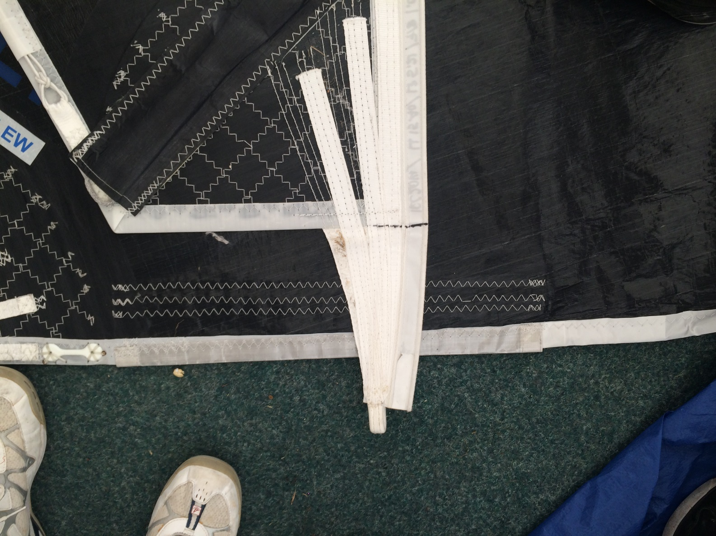
Headsail Head Points
Remember – Excluding Attachments!
But don’t forget that the Aft Head Point could be the highest point

Slide 21
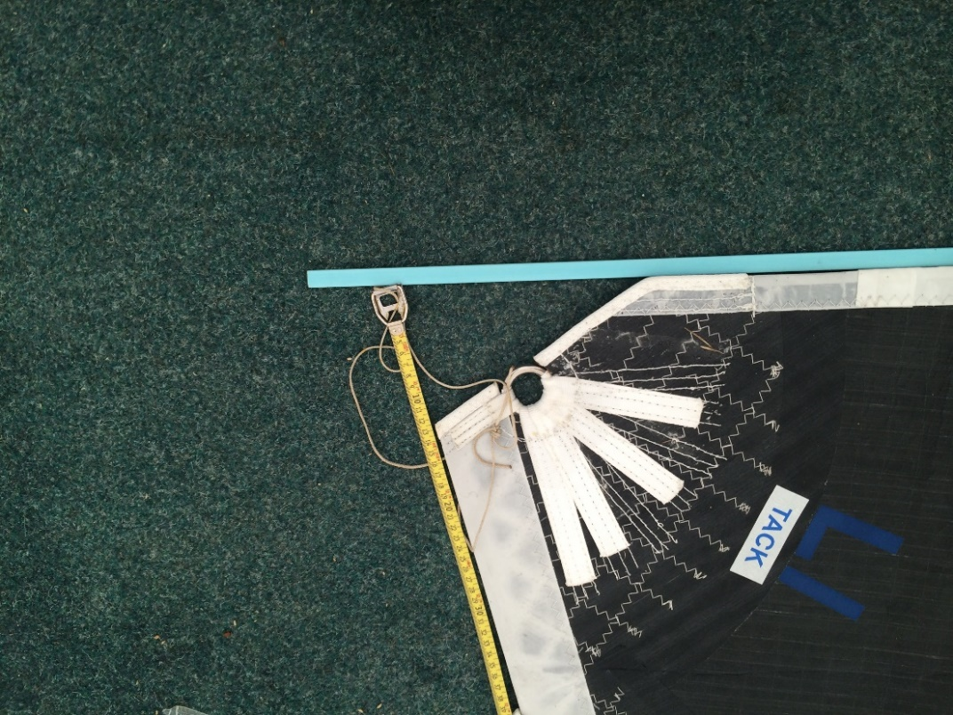
Headsail Tack Point
As Headsail Luff Length is rated, there have been attempts to reduce it.

Slide 22
Hollows
Again Don’t Forget Them – One of the most common discrepancies found during equipment inspection.

Slide 23
Spinnakers
Required Dimensions
Check that SHW Greater Than 75% SFL – Otherwise it’s not a Spinnaker – If it is start again measuring as a Headsail!

Slide 24
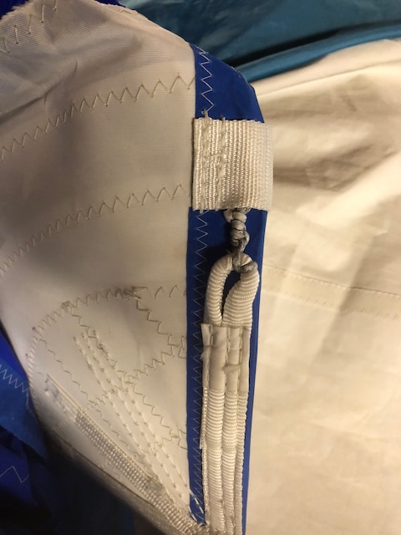
Don’t Forget
Leech + Luff Lines

Slide 25
Spinnaker Dimensions
Definition:
A spinnaker is defined as a sail set forward of the foremost mast with half width (measured as a spinnaker) equal to or greater than 75% of foot length and without battens.
Any other sail tacked down forward of the foremost mast is a headsail.
No differentiation between symmetric and asymmetric spinnakers.
Measure luff, leech, half width and foot (SLU, SLE, SHW, SF).
SHW is measured between the half luff and half leech points.
SPA is calculated from:
SPA = ((SLU + SLE)/2) * ((SF + (4 * SHW))/5) * 0.83
IRC does not need linear dimensions, just SPA:
But please submit linear dimensions as well for check purposes.
SPA is limited, NOT linear dimensions.
Confirm the number of spinnakers that a boat will carry when racing.

Slide 26
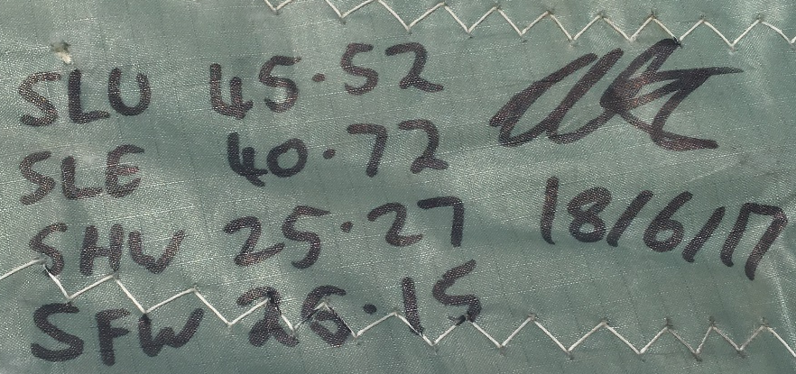
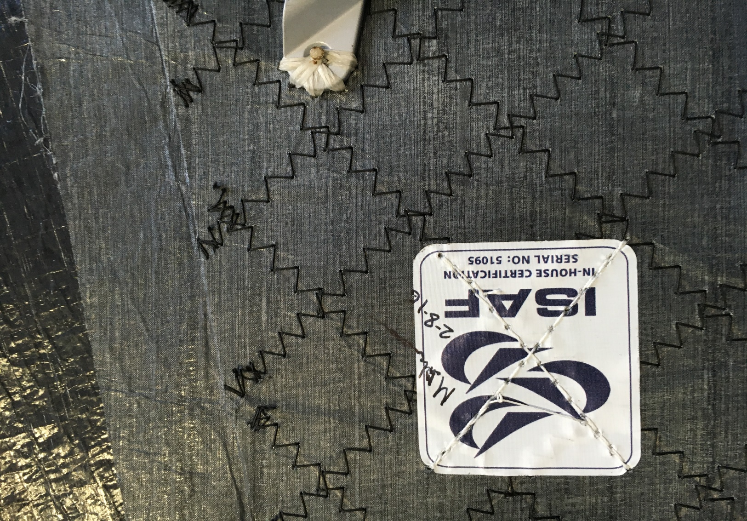
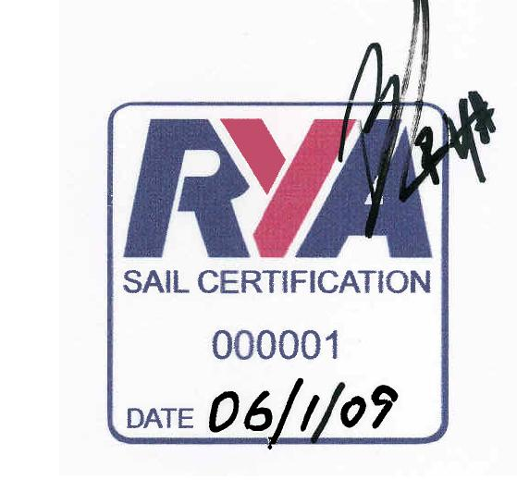
Sail Marking
On completion of measurement RORC Appointed sail measurers to record dimensions + sign & date head of the sail.
RYA Appointed Sail Measurers to apply RYA Sail Certification Sticker

Slide 27
The End

Slide 28
Extras
Find ½ Luff & Leech Points by Measurement
Certification Mark
Code Zero – Measured as Spinnaker – What if cable can’t be removed
Let Off Leech Lines

